Slide 1




Virtual Hackathon-AI FOR ALL
H
A
C
K
@
S
R
E
T
Team No: HT111
Domain Name: Computer Vision
Title: AI System for Smart Infrastructure
Vignesh N
36821024
Sasi Cladin J A 36821022
Kamaleshwaran M 36821017

Slide 2
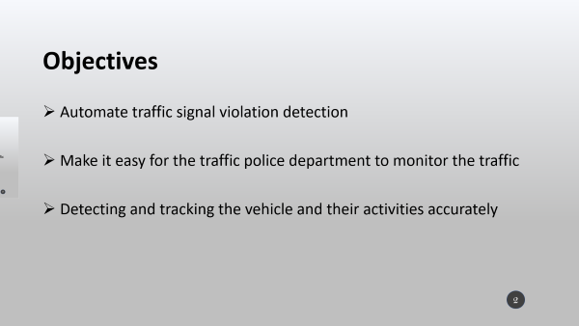
Objectives
Automate traffic signal violation detection
Make it easy for the traffic police department to monitor the traffic
Detecting and tracking the vehicle and their activities accurately
2

Slide 3
OVERVIEW
The System contains two main components –
Vehicle Detection Model (YOLOv3)
Graphical User Interface (Tkinter)
3

Slide 4
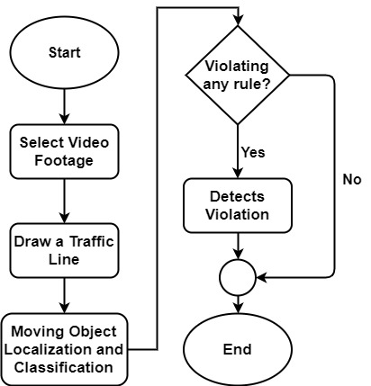
System Overview
4

Slide 5
Methodology
Vehicle Classification:
An object detection model YOLOv3 is used to classify moving vehicles.
Features of the model:
Bounding Box Predictions
Class Prediction
Predictions across scales
Feature Extractor
5

Slide 6
Methodology (Cont.)
Bounding Box Predictions:
The network predicts 4 coordinates for each bounding box. YOLOv3 predicts an objectiveness score for each bounding box using logistic regression. 1 means complete overlap of bounding box prior over the ground truth object. It will predict only 1 bonding box prior for one ground truth object and any error in this would incur for both classification as well as detection loss.
6

Slide 7
Methodology (Cont.)
Class Prediction:
YOLOv3 uses independent logistic classifiers for each class instead of a regular softmax layer. This is done to make the classification multi-label classification. Each box predicts the classes the bounding box may contain using multilabel classification.
7

Slide 8
Methodology (Cont.)
Predictions across scales:
YOLOv3 predicts boxes at 3 different scales
Features are extracted from each scale by using feature pyramid networks
There are 3 bounding box priors per scale and thus total 9 bounding box priors
8

Slide 9
Methodology (Cont.)
Feature Extractor:
YOLOv3 uses a new network Darknet-53. Darknet-53 has 53 convolutional layers.
9

Slide 10
Methodology (Cont.)
Violation Detection:
The vehicles are detected using YOLOv3 model. After detecting the vehicles, violation cases are checked. A traffic line is drawn over the road in the preview of the given video footage by the user. The line specifies that the traffic light is red. Violation happens if any vehicle crosses the traffic line in red state.
The detected objects have a green bounding box. If any vehicle passes the traffic light in red state, violation happens. After detecting violation, the bounding box around the vehicle becomes red.
10

Slide 11
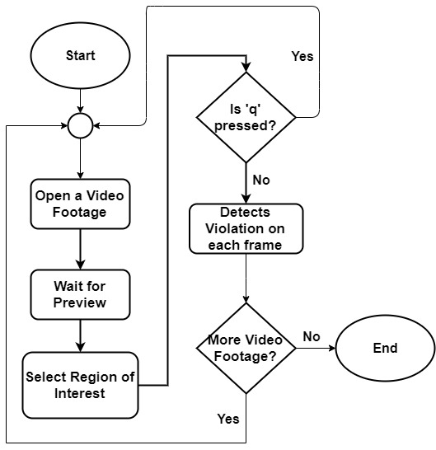
Software Overview
11

Slide 12
Implementation
Computer Vision:
OpenCV is an open source computer vision and machine learning software library which is used in this project for image processing purpose. Tensorflow is used for implementing the vehicle classifier with darknet-53.
12

Slide 13
Implementation (Cont.)
Graphical User Interface:
Tkinter library has been used to build the GUI. The graphical user interface has all the options needed for the software.
13

Slide 14
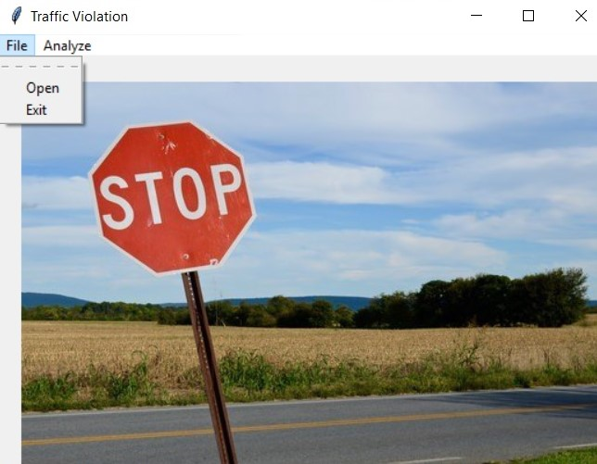
Implementation (Cont.)
Home Page
14

Slide 15
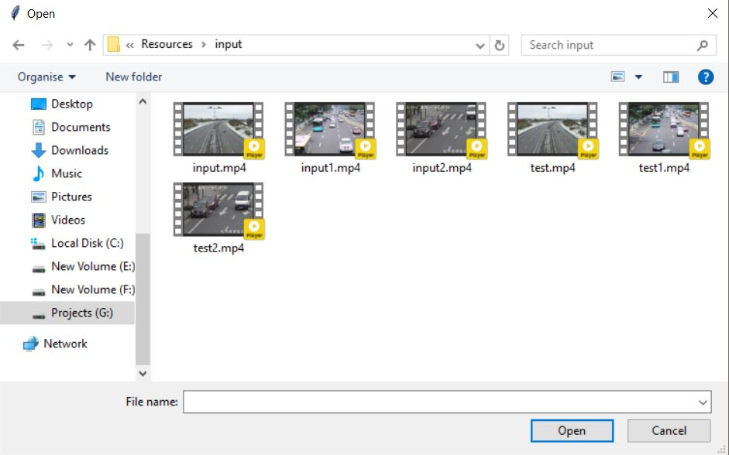
Implementation (Cont.)
Opening a video footage from storage
15

Slide 16
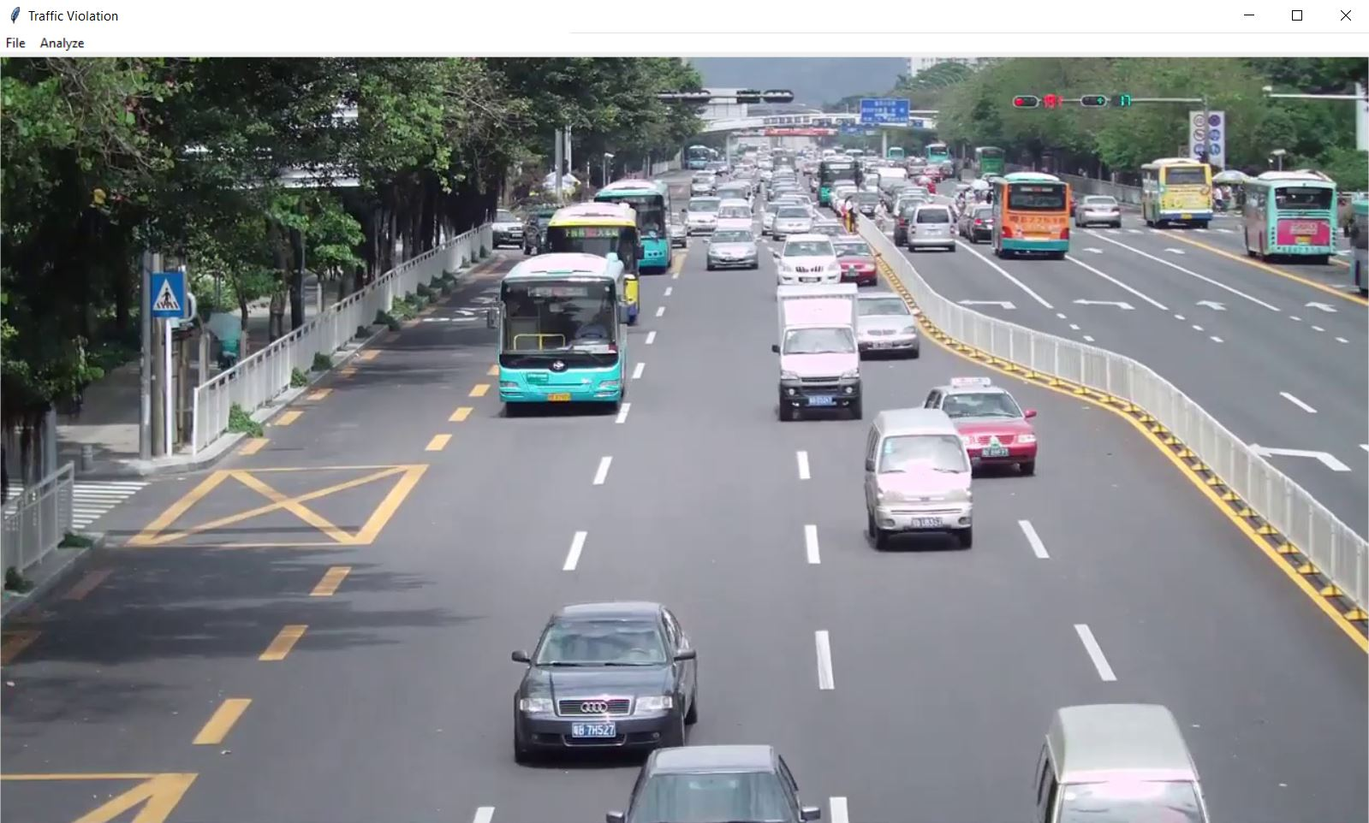
Implementation (Cont.)
Preview Loaded for specific video footage
16

Slide 17
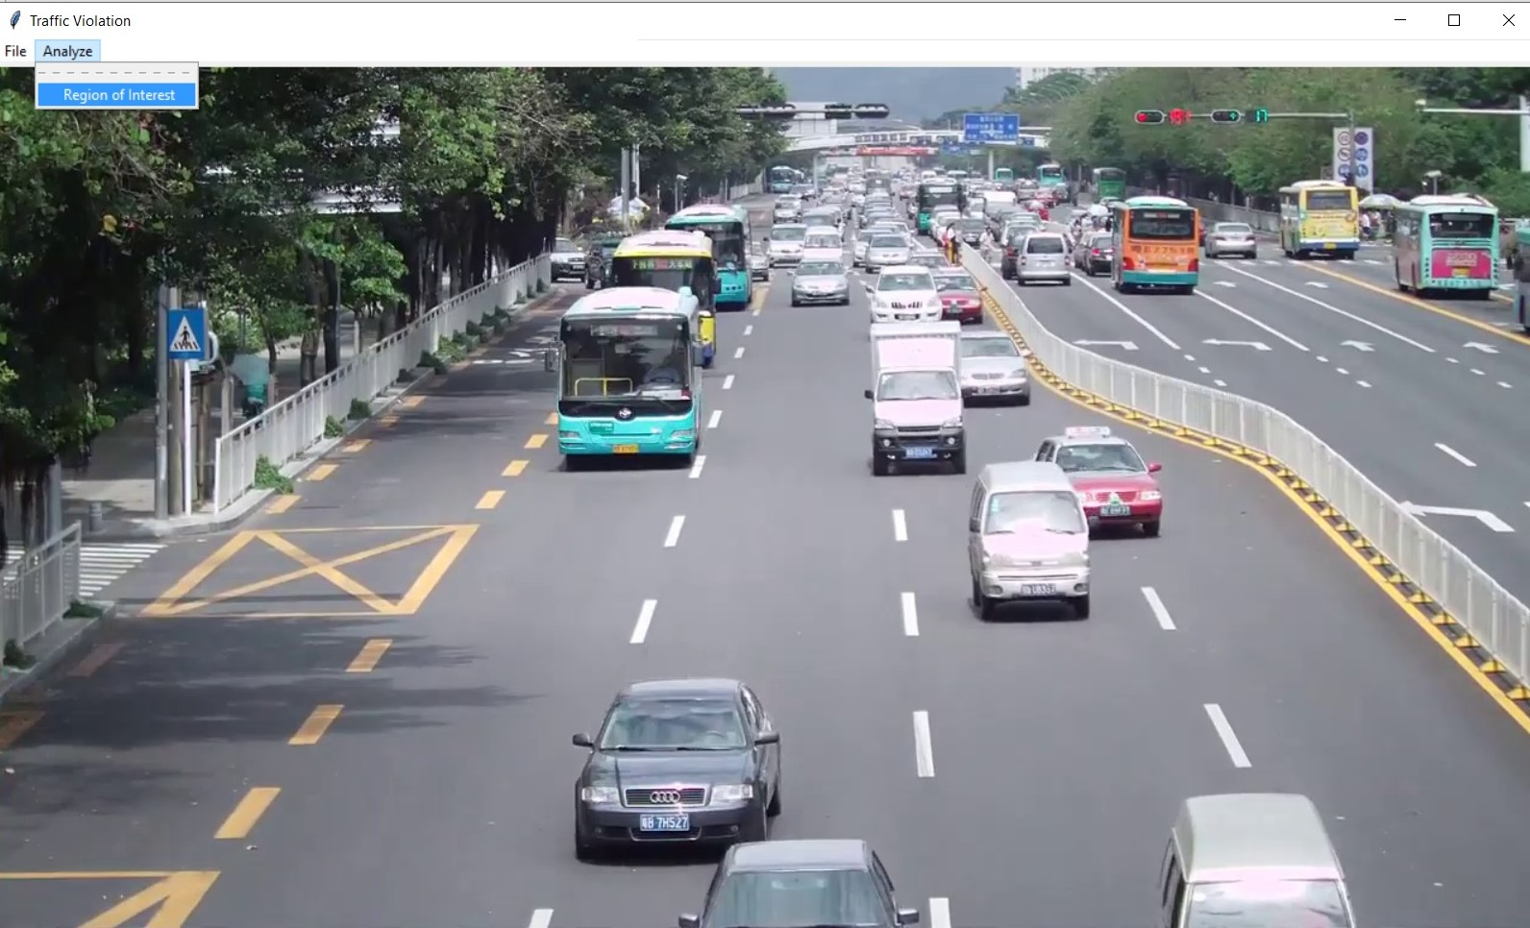
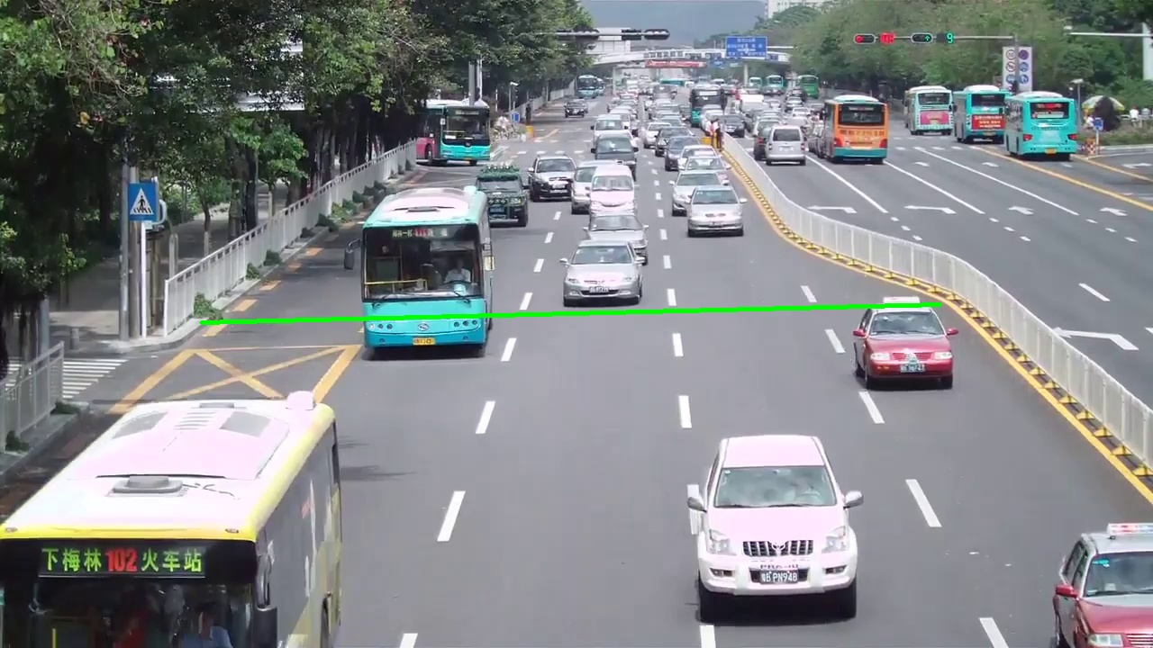
Implementation (Cont.)
Region of Interest
(Drawing Signal Line)
17

Slide 18
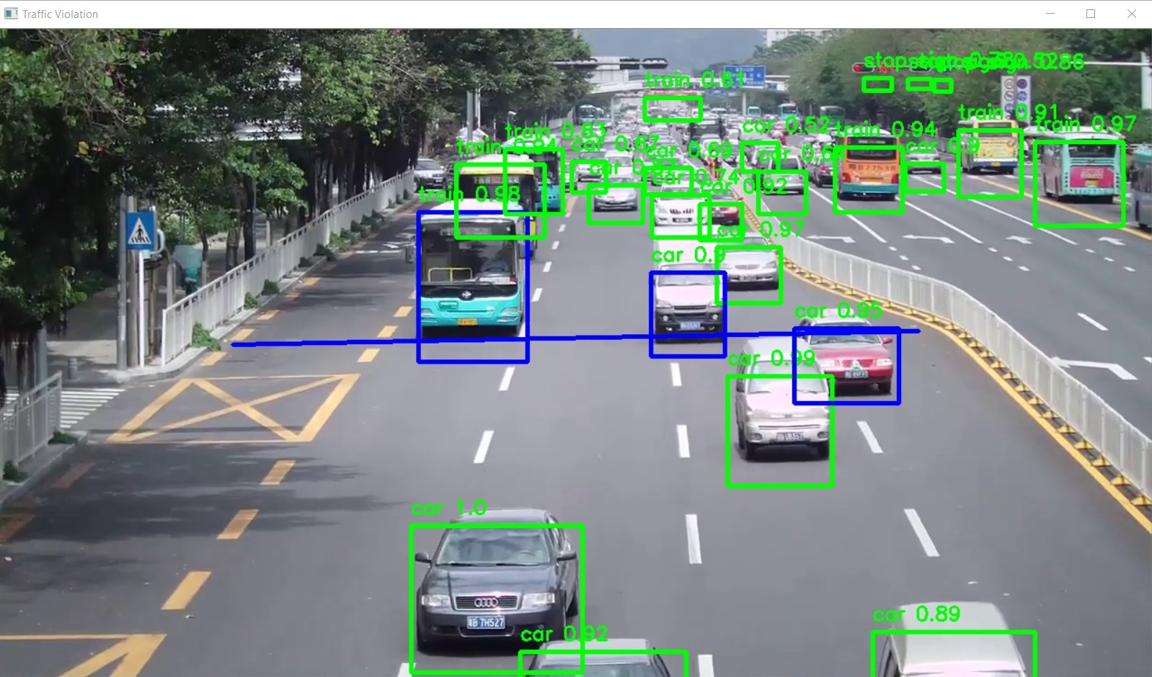
Implementation (Cont.)
Final Output
(on each frame)
18

Slide 19
Future Plan
Adding more real life features
Making this system more robust
Adding Number Plate Detection with OCR support
Adding more traffic violation conditions
19

Slide 20
THANK YOU
20

